Slide 1
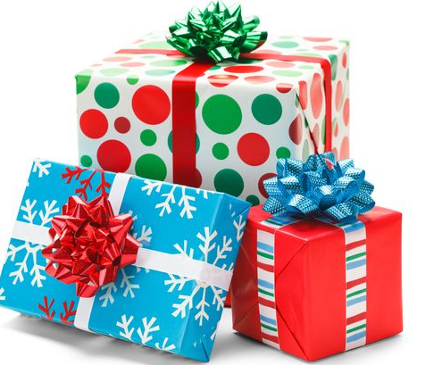
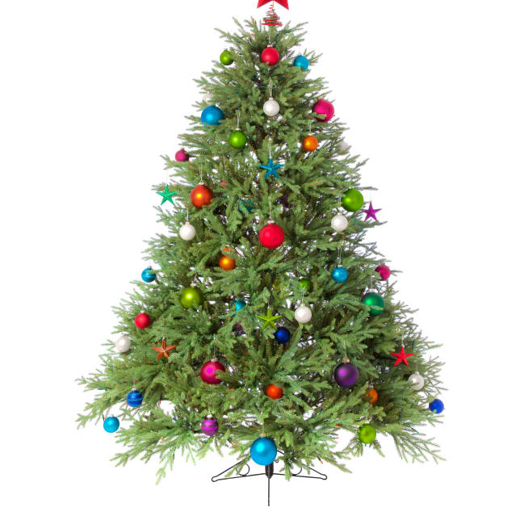
The Giving Tree 2020 St Joseph’s and The English Martyrs, Bishop’s Stortford

Slide 2
What is it?
The Giving Tree is our annual advent charitable present-giving endeavour to support children of the St Francis Family Centre in Poplar, East London.
Here’s a bit about the Centre, run by the Catholic Children’s Society (from their website) to show how valuable this scheme is…

Slide 3
“St Francis helped with my child and family situation when we had nowhere else to turn. Really wonderful and helpful. Things would have been a lot worse if you were not there”
(Mother of a two year old girl)
St Francis Family Centre
St Francis is based in Poplar, Tower Hamlets. This area has the highest rate of child poverty in the country, more than double the national average. Many of the families we work with live in crowded and dilapidated accommodation and struggle to afford basic essentials for their children.
At our family centre we work in partnership with parents to provide outstanding pre school education, giving disadvantaged children the best possible start in life.

Slide 4
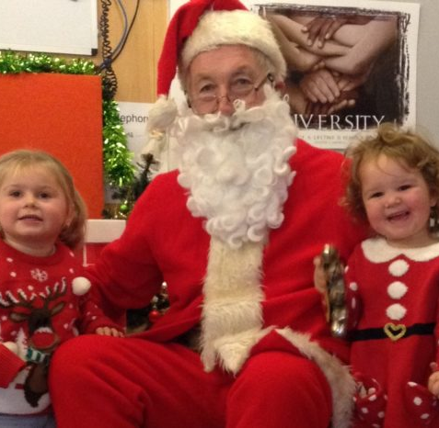
Why this is needed
The most crucial stage in children’s development is their first few years of life. Children from disadvantaged backgrounds frequently begin primary school lagging far behind their more affluent peers.
It is vital that disadvantaged children receive the support they need at an early stage so they can make a successful transition to school and achieve their full potential.
Presents and Hampers at Christmas complement the services we provide.
“I’m afraid to think of what our lives would have been like if I hadn’t found St Francis. You have given me the opportunity to not only change my life, but to give Sara a better life than I had”
(Mother of Sara, aged two)

Slide 5
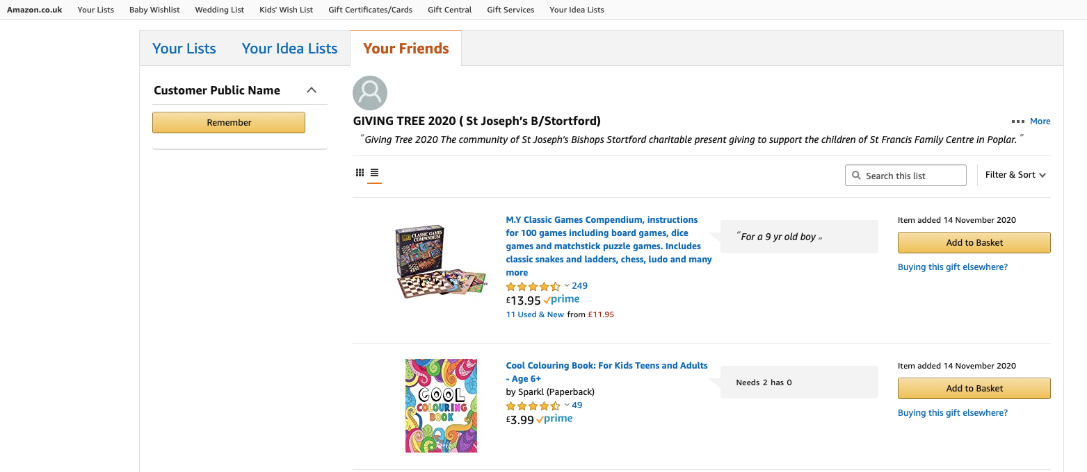
How do I take part?
https://www.amazon.co.uk/hz/wishlist/ls/1JAV7LGOSOR8N?ref_=wl_share
This year, because of Covid 19 restrictions, we have set up an online “Wishlist” with Amazon, at the above web address.
All you need to do is use this link, which will take you to this page:

Slide 6
How do I take part?
Once on the wishlist page is choose your gift and then click “add to basket”. Once you are happy with your choice, head to the checkout in the usual way.
**Be careful when you get to the page “Choose your delivery address”. We are sending the gifts directly to the St Francis Centre, so You MUST click on “Other Addresses” and choose the GIVING TREE address! (Margaret Wilkinson’s Gift Registry Address)**
Here’s the screenshot of that page:

Slide 7
The Children you will be helping! Let’s give them a really special Christmas…

Slide 8
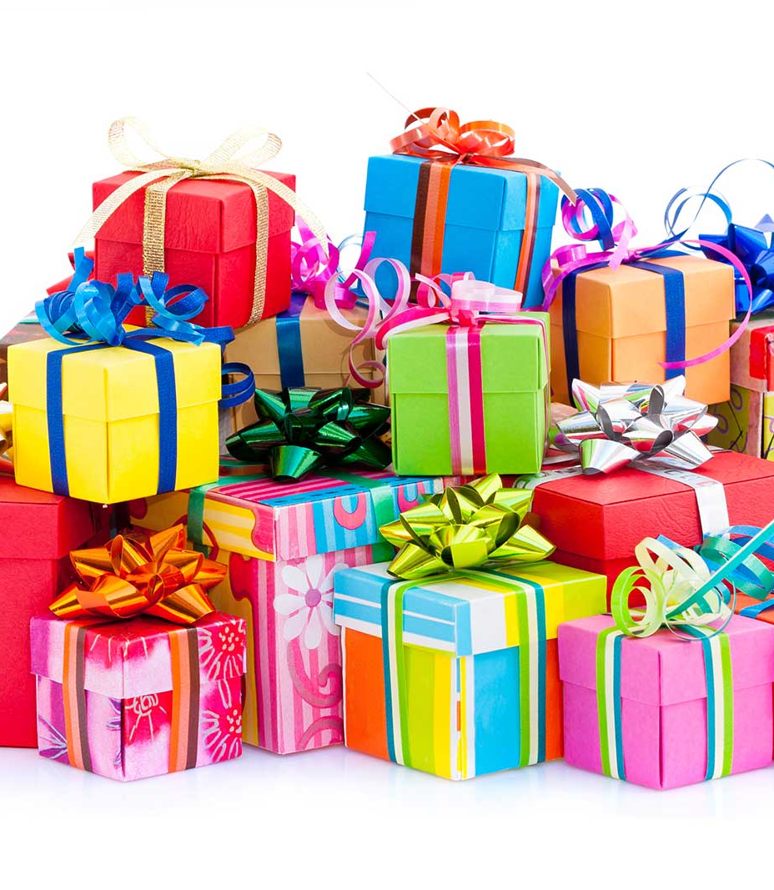
Please remember…
Gifts need to be received by the Centre by
Friday 11th December
– so please order your gift to arrive by then.
Thursday 10th December would be the last day for Prime deliveries please!

Slide 9
Thank you for your generosity

Slide 10
A reminder of the link you need…
https://www.amazon.co.uk/hz/wishlist/ls/1JAV7LGOSOR8N?ref_=wl_share
With lives so blessed, it’s wonderful to be able to give back…
THANK YOU!
Gone - Royalty-Free Music by https://audiohub.com

