Slide 1
Resources for Parish Evangelisation Teams

Slide 2
Books

Slide 3
The Aparecida Document
The final document of the V General Conference of the Episcopate of Latin America and the Caribbean which met for the 13-31 May 2007 on the theme: Disciples and Missionaries of Jesus Christ so that our peoples may have life in Him. "I am the Way, the Truth and the Life" (Jn 14:6).
Author: Jorge Mario Bergoglio
We worth reading but quite demanding – key aspects are captured in Evangelii Gaudium, which is a easier place to start!
Notes:
A RECOGNITION OF THE PROBLEM – A CHURCH WHERE FAITH NEEDS TO BE LIVED
The Aparecida Document
The final document of the V General Conference of the Episcopate of Latin America and the Caribbean which met for the 13-31 May 2007 on the theme: Disciples and Missionaries of Jesus Christ so that our peoples may have life in Him. "I am the Way, the Truth and the Life" (Jn 14:6). This document contains numerous indications rich pastoral reflections in the light of faith and the current social context. There are ten chapters in three parts: Part One: 1. The Disciples in Mission 2. Look of the Disciples in Mission About Reality Part 3. The Joy of Being Disciples missionaries to proclaim the Gospel of Jesus Christ 4. The Calling of the Disciples in Mission to Holiness 5. The Communion of the Church Missionary Disciples in June. The Formative Itinerary Missionary Disciples Part Three: 7. Disciples Mission Service Full Life 8. Kingdom of God and Promotion of Human Dignity 9. Family, People, and Life 10. Our People and Culture
‘This document contains an abundance of timely pastoral guidelines, explained in a wealth of reflections in the light of faith and of the contemporary social context.’ - Pope Benedict
Look to Jesus for the answers to today’s challenges - a focus on mission, to become ‘Missionary Disciples’ – Jesus brings joy to us and others, . “the joy of being called to proclaim the Gospel” ; “new faces of the poor,” including the unemployed, migrants, and those who are abandoned or ill, and highlights the urgent need to care for the environment. The Catholic Church must honestly ask herself what is missing in her presentation of the Gospel and the authentic, full living of the Gospel.
THOSE WHO HAVE LEFT THE CHURCH TO JOIN OTHER RELIGIOUS GROUPS
In our pastoral experience, often sincere people who leave our church do not do so because of what “non-Catholic” groups believe, but fundamentally for what they live
we should enhance work along four
Religious experience. In our Church we must offer all our faithful “a personal encounter with Jesus Christ,”
Community life. Our faithful are seeking Christian communities where they are accepted fraternally and feel valued, visible, and included in the Church
Biblical and doctrinal formation. our faithful need to deepen their knowledge of the Word and the contents of the faith, - to bring their religious experience to maturity.
Missionary commitment of the entire community. To go out to meet those who are afar, to show concern and so attract them back to the Church
invite them to return to it.
ECUMENICAL AND INTERRELIGIOU

Slide 4
Evangelii Gaudium – The Joy of the Gospel The first Apostolic Exhortation from Pope Francis.
“The Joy of the Gospel fills the hearts and lives of all who encounter Jesus. Those who accept his offer of salvation are set free from sin, sorrow, inner emptiness and loneliness. With Christ joy is constantly born anew. In this Exhortation I wish to encourage the Christian faithful to embark upon a new chapter of evangelization marked by this joy, while pointing out new paths for the Church s journey in years to come”.
Pope Francis (Evangelii Gaudium)
Evangelii Gaudium is the key document to read as it brings together many aspects of evangelisation from previous Popes, and sets the scene for all to be ‘Missionary Disciples.
Notes:
JOY IN FAITH – JOY IN SHARING THE FAITH – ALL TO BE MISSIONARY DISCIPLES
Pope Francis puts forward his vision for:
a missionary Church, renewal in living faith,
“The Joy of the Gospel fills the hearts and lives of all who encounter Jesus. Those who accept his offer of salvation are set free from sin, sorrow, inner emptiness and loneliness. With Christ joy is constantly born anew. In this Exhortation I wish to encourage the Christian faithful to embark upon a new chapter of evangelizationmarked by this joy, while pointing out new paths for the Church’s journey in years to come”
“I dream of a 'missionary option', that is, a missionary impulse capable of transforming everything, so that the Church’s customs, ways of doing things, times and schedules, language and structures can be suitably channeled for the evangelization of today’s world rather than for her self-preservation”
The Basic Proclamation of the Gospel (Kerygma);
Proclamation – accepting God in our lives – all the baptised are to be missionary disciples – to see the parish as the centre of missionary outreach – to reach out to the poor. The joy of the Gospel is for all people: no one can be excluded.” (#23).

Slide 5
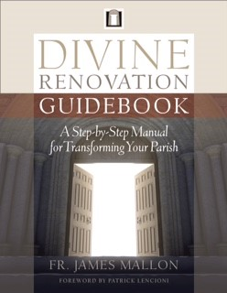
Divine Renovation - Fr James Mallon bringing your parish from maintenance to mission
Highly acclaimed and widely used, Fr. James Mallon shares his experience from St Benedict’s Parish, Halifax, Nova Scotia. Good summary of background development of New Evangelisation in the Church. Reviews approaches to parish involvement including provision of sacraments. Practical solutions to changing a parish from one of ‘maintenance to one of mission’.
Cost around £15
Also Parish Guide, Website and Networks.
Conference at St Mary’s Twickenham in autumn.
Challenging discussion on evangelisation in a parish. Many practical ideas. A focus on developing leadership teams, which will be suited to some parishes more than others.
Notes:
FROM MAINTENANCE TO MISSION – FOCUS ON VALUES TO RENEW THE CULTURE OF THE PARISH
Challenging the culture of maintenance in our local church – to boldly share our faith. A practical guide to spiritually renovating our parishes by: focusing on people – not on structures that don’t serve the church’s mission; supporting values and culture that matters; to be welcoming as a parish; restoring a proper recognition of sacraments.

Slide 6
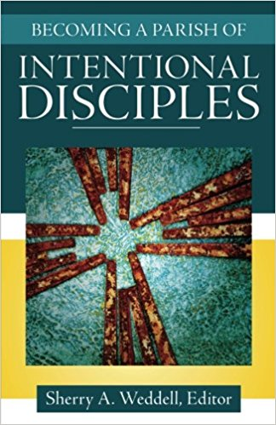
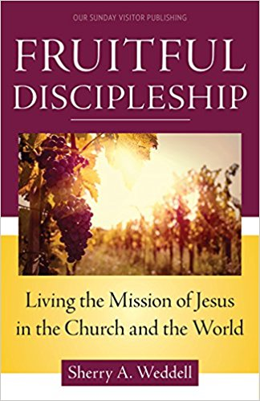
Forming Intentional Disciples by Sherry Weddell
Widely used resource, Sherry Weddell looks at five thresholds of conversion: trust >>> curiosity >>> openness >>> seeking >>> leading to intentional discipleship. Also look at statistics of Church decline (in USA). A focus on talking about faith and a personal relationship with Jesus.
Also book on parish, and new book on ‘Living the Mission…’ out 7th June 2017.
Costs around £10 / £11 / £15
A useful insight into the nature of evangelisation. Statistics (from USA) reveal underlying challenges being faced by parish teams.
Notes:
A PROCESS OF EVANGELISATION FOR THE MODERN WORLD – INTENTIONAL DISCIPLESHIP
Widely used resource, Sherry Weddell looks at five thresholds of conversion: trust, curiosity, openness, seeking, leading to intentional discipleship. Also look at statistics of Church decline (in USA). A focus on talking about faith and a personal relationship with Jesus.
Also book on parish, and new book on ‘Living the Mission…’ out 7^{t}June 2017.
An important resource in development of Evangelisation Teams – to understand the process of evangelisation
Relevant to ‘New Evangelisation.
^{Anh}

Slide 7
Purpose Driven Church by Rick Warren
An in-depth look at churches leads Rick Warren to present a model for a balanced church which is purpose driven. Wide range of relevant scriptural texts support his work. Provides a framework for parish development and integrated evangelisation.
Costs around
Certainly a book for the shelf! Supported by many years of experience, it sets evangelisation within the context of overall parish life, and how it is important to maintain a balanced and so a resilient parish.
Notes:
A BALANCE IN CHURCH LIFE – WITH PURPOSE
The five purposes for Saddleback Church are: “Magnify: We celebrate God’s presence in Worship, Mission: We communicate God’s Word through evangelism, Membership: We incorporate God’s family into our fellowship, Maturity: We educate God’s people through discipleship [and lastly] Ministry: We demonstrate God’s love through service.”

Slide 8
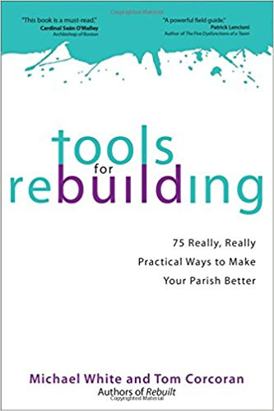
Rebuilt by Fr Michael White and Tom Corcoran
The struggles and successes of changing a declining parish into and growing, vibrant parish are captured by Fr Michael White and his lay colleague Tom Corcoran. They warn against ‘consumer Catholics’, and point the need for a clear parish strategy that ensures participation by all in meeting the needs of the community. The ‘Tools’ companion provides practical suggestions based on their experiences. A widely used book in USA.
Costs around £12 / £13
Useful stories on the experiences of growing an evangelised parish in a modern world. Enthusiastic resource for teams.
Notes:
FROM MEETING THE DEMANDS OF THE CONSUMER – TO REACHING OUT TO THE LOST
Fr. Michael White and his associate Tom Corcoran were faced with challenges typical of many parishes: declining attendance, youth leaving once confirmed, lack of finances, old facilities, burned-out volunteers, and an overall sense of decline, variable liturgy. They turned the parish round through:
Focus on the ‘lost’ – fallen away Catholics and unchurched, rather than just catering to the demanding, present ‘consumers’;
Prioritising the ‘weekend experience’;
Challenging existing parishioners to get involved in volunteering and evangelizing.
To be welcoming, with a liturgy is inspiring and a message that is relevant.
Music, message and ministry

Slide 9
Tomorrow’s Parish by Donal Harrington
Looking at the decline of the Church in Ireland, Donal Harrington considers underlying principles that are to form the basis for the future parish. He describes the need to ‘reach in’ – for the faithful to grow, so that they can ‘reach out’ – to take on the mission of evangelisation. Very thought-provoking.
Costs around £12
Notes:
PARISH LIFE – INSIGHTS, ORGANISATION, MOVING FORWARD
(Ireland)
A welcoming parish is a place where people do not just hear but also feel the Good News of the gospel. The book reflects the growing sense that evangelisation is first and foremost about welcome.
A parish community that is touched by the Good News; and in touch with people in their lives. A parish where the good news in heard and people are being introduced to Jesus Christ.
A listening parish – understanding the context of the parish, both to people inside and outside the parish. Situating ourselves so that we can reach in and reach out.
Reaching in – about rediscovering ourselves. To come to a new sense of what it is to be a parish: Gospel inspired, alive and active, with everyone particpating.
Reaching out – the parish expressing itself through caring, welcoming, listening and praying.
Organising the parish – mobilising the faith community for its mission.

Slide 10
New Evangelisation Pastoral Strategy for the Church at the Beginning of the Third Millennium
Archbishop Julian Porteus, of Hobart Diocese, Tasmania, Australia, brings together his understanding of what evangelisation entails, built on forty years of experience in ministry. An in-depth look at the history of evangelisation in the Church, and development of the ideas of ‘New Evangelisation’ in modern times, and its practical application in the modern world. The book expresses the deep conviction that the New Evangelisation must be the pastoral strategy for the Church as it enters the third millennium of Christianity. Cost: £12
Notes:
UNDERSTANDING MODERN CULTURE – WITH STRATEGIES FOR PRACTICAL EVANGELISING.
(Australia)
New Evangelisation_ Pastoral Strategy for the Church at the Beginning of the Third Millennium
Looking at what evangelisation and New Evangelisation means. He looks at present culture and how that presents new opportunities to evangelise in new ways – whether through an information stall in the market, knocking on doors or social media.
Practical and inspiring; how to evangelise in an increasing secular society

Slide 11
Great Catholic Parishes by William E. Simon Jr
William Simon, an American businessman, philanthropist and politician has identified four key aspects of vibrant parishes: shared leadership, spiritual maturity & discipleship, excellent Sunday worship and a spirit of evangelisation. A useful guide on where to focus energy in developing parish life.
Costs around £13
Notes:
WHAT IS IT THAT MAKES A VIBRANT PARISH?
William Simon surveys 244 vibrant parishes to understand what makes a successful parish.
Key aspects are: shared leadership, spiritual maturity & discipleship, excellent Sunday worship, a spirit of evangelisation.
Share leadership - by using clergy and lay staff with the best talents and skills to direct the community
Foster spiritual maturity and plan for discipleship - by offering a variety of formation programs and ministry opportunities to reach parishioners at differing points in their lives
Excel on Sundays - by dedicating significant time, energy, and money to liturgical celebrations that parishioners and visitors find welcoming
Intentionally evangelize - by challenging insiders to look outward and providing service programs, social events, global mission opportunities, and pastoral care at key sacramental moments that focus on inviting outsiders to deeper relationship with Christ and the Church.
Each chapter closes with either crucial takeaways or a summary of practical challenges that will help pastors and leaders focus on growth and excellence

Slide 12
Evangelizing Catholics by Scott Hahn
Scott Hahn explores what evangelisation means, looking at The Call: Understanding the New Evangelization, The Response: Models and Methods for the New Evangelization, and The Message: The Content of the New Evangelization. There is reference to the documents of Vatican II and successive Popes. Evangelisation is a life long process in which we are all to be involved. A practical guide to mission.
Costs around £13
Notes:
"New Evangelization," that's simply a reminder to us of what has always been true.
In this this very practical "mission manual" Dr. Hahn equips you with:
A guide to understanding what the New Evangelization is, and who it's really for
A roadmap that leads you to where it all happens (hint: it's closer than you think)
A simple, beautiful message to share - in words and actions
Enter a deeper friendship with Christ, and you'll want to share his companionship more and more with a wider circle of friends.

Slide 13
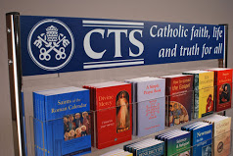
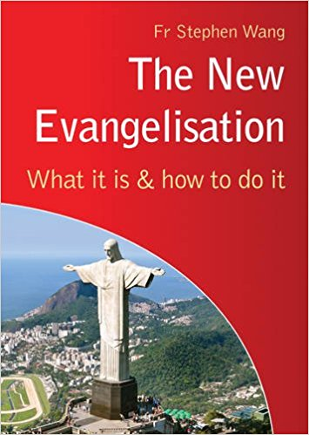
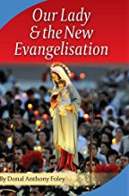
Evangelisation Hubs

Slide 14
Videos & Programmes

Slide 16
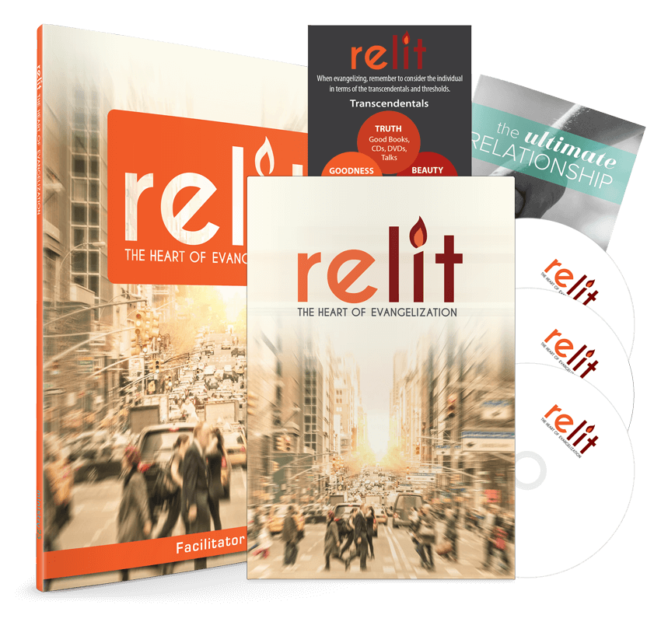
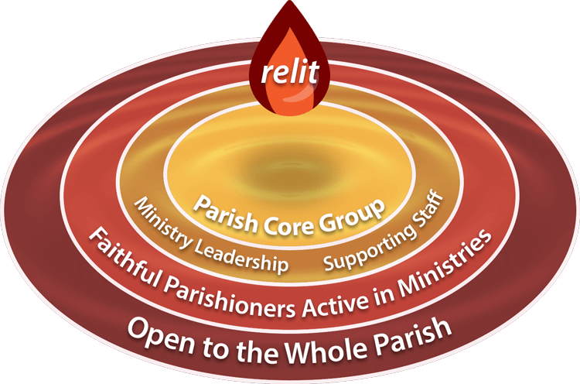
Michael Dopp inspires a new look at growing evangelising parishes, building on inspirational Church documents and the growth of evangelisation teams. Provides a supporting programme for parishes.

Slide 17
Being brought up to date in autumn 2018. Substantial work from Fr Stephen Wang, which provides a sound starting point for new evangelisation.
Sycamore is first of all a tool for ‘primary evangelisation’

Slide 18
Increasingly popular with Catholic parishes. Recently update, and provides good starting point for discussion and exploration of faith.

Slide 20
Liturgical Calendar
Through the year, there are a range of opportunities to new and renewed engagement and involvement - for new evangelisation – ‘leading people to meeting Jesus for the first time, or as if for the first time’.

Slide 21
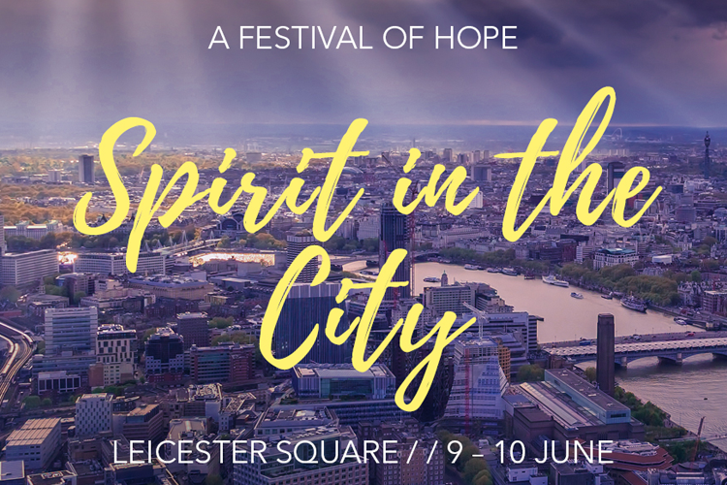
10th–19th May 2018
Events provide inspiring opportunities for engaging with people interested to know more.

Slide 22
Bible Sunday – 10th Dec 2018

Slide 23
Websites Proclaim’15 – Resources
http://rcdow.org.uk/faith/proclaim-westminster/
http://www.catholicnews.org.uk/Home/Special-Events/Proclaim-15-Building-Missionary-Parishes/Parish-Evanglisation-Series

Slide 24
Funds - £
St Faustina Fund
Grants of around £200 to assist parishes who are creating or have existing evangelisation teams with evangelisation.
To help to encourage and enable teams to be formed and develop.
To support, enable and encourage outreach projects at parish level.
Parishes to match funds.
Applications through Agency for Evangelisation
Catenians and similar organisations

Slide 25
Prayer

