Slide 1
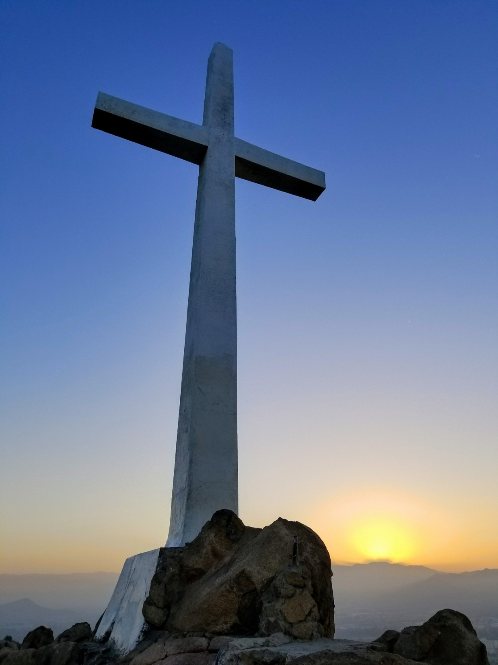
A WAY OF THE CROSS
United in Solidarity with People in Myanmar
Opening Prayer
God of merciful and compassion, we are here to journey in spirit with our sisters and brothers in Myanmar in their courage and commitment to bring peace and freedom in this world particularly in their beloved country. May the life of Jesus strengthen us to manifest the power of nonviolence, to reconcile humanity in love, justice and peace.

Slide 2
1. JESUS IS CONDEMNED TO DEATH TODAY
In the early hours of Monday, February 1st 2021, the army's TV station said power had been handed over to commander-in-chief Min Aung Hlaing. Ms Aung San Suu Kyi, President Win Myint and other leaders of the National League for Democracy (NLD) were arrested in a series of raids. It is not clear where they are being held. No major violence has been reported. Soldiers blocked roads in the capital, Nay Pyi Taw, and the main city, Yangon. International and domestic TV channels, including the state broadcaster, went off air. Internet and phone services were disrupted. Banks said they had been forced to close. Later, the military announced that 24 ministers and deputies had been removed, and 11 replacements had been named, including in finance, health, the interior and foreign affairs. (from BBC News)
Our Father
Hail Mary

Slide 3
2. TODAY JESUS CARRIES HIS CROSS
Thousands of people took to the streets of Yangon in the first major organized demonstration since the military seized power in a coup earlier this week.
The crowd, many of whom could be seen waving flags and holding banners, called for the military to release Suu Kyi, and other democratically-elected lawmakers, who were detained in pre-dawn raids Monday. Chants of "We demand democracy" could be heard coming from the crowd as they marched close to downtown Yangon, prompting the government to impose an internet blackout. (CNN, 7 February 2021)
Our Father
Hail Mary

Slide 4
3. TODAY JESUS FALLS THE FIRST TIME
A young woman has become the first protester to die in the anti-coup demonstrations in Myanmar after she was shot in the head last week. Mya Thwe Thwe Khaing was injured two days before her 20th birthday when police tried to disperse protesters. (BBC News, 19 February 2021)
Our Father
Hail Mary

Slide 5
4. TODAY JESUS MEETS HIS MOTHER MARY
Myanmar brave nun makes a stand in Myanmar Sister Ann Rosa Nu Tawng's resolve to protect peaceful protesters draws global praise (UCA News, 2 March 2021)
Sister Ann Rosa Nu Tawng kneels and pleads with security personnel not to shoot unarmed civilians in Myitkyina, capital of Kachin state, on Feb. 28.
Undeterred by fear, Sister Nu Tawng knelt down before the security personnel, pleading with them not to shoot the unarmed civilians.
“Just shoot me if you want to,” said the nun, adding that “the protesters have no weapons and they are just showing their desire peacefully.”
The nun from the Sisters of St. Francis Xavier congregation in Myitkyina, capital of Kachin state, recalled that security personnel told her to leave as she was in grave danger, but she insisted she would not go away and was ready to die.
“I have prepared myself that I will give my life for the Church, for the people and for the nation,” she said.
Our Father
Hail Mary

Slide 6
5. TODAY SIMON HELPS JESUS CARRY HIS CROSS
Medics risk lives to treat injured in Myanmar anti-coup protests. Mobile clinics have been set up to treat sick and those wounded in protests, but healthcare workers say their biggest challenge is ‘not to get shot’. (Aljazeera News)
Our Father
Hail Mary

Slide 7
6. TODAY VERONICA WIPES THE FACE OF JESUS
Thousands of mostly silent demonstrators paraded through central Tokyo on Sunday in protest against the coup in Myanmar, many carrying photos of detained leader Aung San Suu Kyi in what organisers said was the largest such march in Japan to date.
More than 4,000 took part in the protest, organisers said, streaming through the downtown shopping areas of Shibuya and Omotesando with posters saying "Help us save Myanmar" and "Stop Crimes Against Humanity". Tokyo police said they couldn't comment on how many people attended the event. (Reuters, 14 February 2021)
Our Father
Hail Mary

Slide 8
7. TODAY JESUS FALLS A SECOND TIME
The U.N. Human Rights Office said it had received “credible information” that at least 18 people were killed and more 30 were wounded, in the highest single-day death toll since the military takeover brought hundreds of thousands of protesters into streets across the country of 54 million people.
“We strongly condemn the escalating violence against protests in Myanmar and call on the military to immediately halt the use of force against peaceful protestors,” the rights office said in a statement. (Radio Free Asia, 28 February 2021)
Our Father
Hail Mary

Slide 9
8. TODAY JESUS SPEAKS TO THE WOMEN
"We cannot stay quiet," youth leader Esther Ze Naw told Reuters. "If there is blood shed during our peaceful protests, then there will be more if we let them take over the country." (France 24, 10 February 2021)
Our Father
Hail Mary

Slide 10
9. TODAY JESUS FALLS YET AGAIN
A U.N. official speaking from Switzerland said 38 people had been killed Wednesday, a figure consistent with other reports though accounts are difficult to confirm inside the country. The increasingly deadly violence could galvanize the international community, which has responded fitfully so far.
“Today it was the bloodiest day since the coup happened on Feb. 1. We have today — only today — 38 people died. We have now more than over 50 people died since the coup started” and more have been wounded, the U.N. special envoy for Myanmar, Christine Schraner Burgener, told reporters at U.N. headquarters on Wednesday. (AP, 4 March 2021)
Our Father
Hail Mary

Slide 11
10. JESUS IS STRIPPED OF HIS GARMENTS
Myanmar's ambassador to the United Nations Kyaw Moe Tun holds up three fingers at the end of his speech to the General Assembly where he pleaded for international action in overturning the military coup in his country, on Feb. 26. (CNA)
Myanmar's military rulers say they have fired the country's ambassador to the United Nations, a day after he called for help to remove the army from power. In an emotional speech, Kyaw Moe Tun said no-one should co-operate with the military until it handed back power to the democratically elected government. UN sources told Reuters that as they do not recognise the junta, Kyaw Moe Tun remains Myanmar's UN ambassador. (BBC News, 1 March 2021)
Our Father
Hail Mary

Slide 12
11. TODAY JESUS IS NAILED TO THE CROSS
In Yangon, Nyi Nyi Aung Htet Naing, an internet network engineer, was among the first causalities, according to Reuters. The day before he was killed he had posted on Facebook about the increasingly violent military crackdown, asking
"#How_Many_Dead_Bodies_UN_Need_To_Take_Action," in reference to the United Nations. (CNN, 1 March 2021)
Our Father
Hail Mary

Slide 13
12. TODAY JESUS DIES ON THE CROSS
Nineteen-year-old Kyal Sin, better known by her nickname Angel, was a singer, dancer and taekwondo champion in Mandalay, Myanmar's second-largest city.
On Wednesday (March 3rd), she donned a black T-shirt with the words “everything will be ok” before heading out to join protests against the military’s seizure of power in a coup on Feb. 1. She was shot in the head and killed, one of at least 38 people who died at the hands of security forces that day alone, according to the United Nations.
(The Washington Post, 4 March 2021)

Slide 14
The last gaze! The last look
Are you looking at the lights to come
Are you looking for light to come on
Are you looking at the heaven you go
Are you looking at heaven to go
Do you know that you are going to be our Hero in a moment?
Did you know you'll soon be our hero
Do you know that this image of you will be surely missed and printed in our heart?
Did you know that this image will definitely be missed in our hearts
Be resting in Peace and watching your dream is fulfilled by your fellow comrades
Rest in peace and watch your dreams be taken by police coworkers.
You all make us crying than the tear gas..
Y ' all made us cry more than a tear bomb.
Our Father
Hail Mary

Slide 15
13. TODAY JESUS IS TAKEN DOWN FROM THE CROSS
World leaders have strongly condemned the bloodiest crackdown yet by Myanmar’s security forces against peaceful anti-coup demonstrators, in which at least 18 people were killed and dozens wounded in several cities across Myanmar, according to the United Nations’ human rights office.
UN chief Antonio Guterres on Sunday led the chorus of international condemnation against the actions of the military, which grabbed power on February 1 and declared a year-long “emergency” after alleging electoral fraud in a November election that was won by civilian leader Aung San Suu Kyi’s party in a landslide.
Meanwhile, activists in a number of Asian countries and elsewhere held rallies on Sunday to support the anti-coup protesters in Myanmar.

Slide 16
Following a call for help from Myanmar pro-democracy campaigners, some 200 people in Taipei and dozens in Bangkok, Melbourne and Hong Kong took to the streets waving #MilkTeaAlliance signs and flags.
The hashtag, which originated as a protest against online attacks from nationalists in China, was used millions of times on Sunday. Its name originates from the shared passion for the milky drink in Thailand, Hong Kong and Taiwan.
Activists in Indonesia and Malaysia and other countries in Southeast Asia expressed their solidarity by posting messages and artwork online as part of a social media campaign.
“Myanmar activists have been very active in engaging with Milk Tea Alliance since the coup,” said Thai activist Rathasat Plenwong, who went to show his support for the Myanmar protests in Bangkok.
“We feel like we’re in this together.”
(Aljazeera, 28 February 2021)
Our Father
Hail Mary

Slide 17
14. TODAY JESUS IS BURIED
Security forces have arrested nearly 1,500 people since the start of the coup, with 1,200 of them still in detention, according to the Assistance Association for Political Prisoners (AAPP) monitoring group.
The group said it had documented more than 50 deaths, as it detailed teenagers and people aged in their 20s who had been shot in the head and chest. (Bangkok Post, 14 March 2021)
Democracy activist Esther Ze Naw told Reuters that the sacrifices of those who died would not be in vain.
“We shall overcome this and win,” she said. (France 24, 3 March 2021)
Our Father
Hail Mary

Slide 18
Prayer for our Sisters, CIM and friends in Myanmar
Sitting L-R: Beta fcJ, Narni fcJ
Standing L-R: Sisca fcJ, Emma (CIM in Formation) and Cecilia fcJ
L-R – Mary Sai (Student),
Genevieve CIM, Aye Min Thant (Student)
Maria fcJ

Slide 19
Closing Prayer
Jesus, our Companion,
Thank you for being gentle, loving compassionate and self-giving.
You are so nonviolent that you inspire us and draw us to live in truth, love and forgiveness. May this journey of solidarity with our sisters and brothers in Myanmar give us courage to choose your way of nonviolence and to create peace and justice on this Earth.
Make us your instrument of peace, that we might, even in a small way, turn war, oppression, violence into freedom, compassion and love. Bless our brother and sisters in Myanmar with your love and care. Bless their passion, courage and great desire for freedom and peace. Touch hearts of the oppressors with your compassion that they too experience the power of the Eternal Love and Peace.
As we are called to follow you, Jesus,
help us to be peacemakers, to live in your peace, love and compassion and to bring your Kindom on this Earth always forever and ever.
Amen.

