Slide 1
Our Lady of the Rosary Staines Parish Finances
July 2022

Slide 2
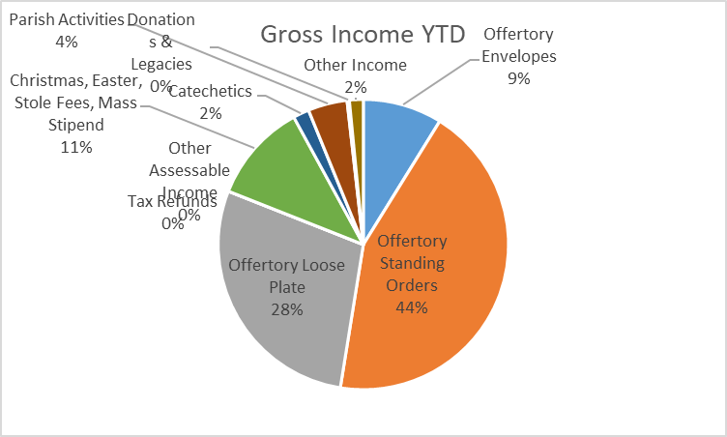
Parish Income
In 2021, the Parish received total income of around £87,000. For 2022, we are forecasting income of around £82,000.
This is a significant amount of money, but the Parish is responsible for the upkeep of this Church and must also provide support to the Diocese (who assess us at 15%-21% of much of OLORS income).
Slightly more than 80% of Parish income comes from Offertory, with most of this from standing orders which grew over Covid. Standing order and envelopes (around 50%) also make it easier for the Parish to claim tax refunds it is entitled to.

Slide 3
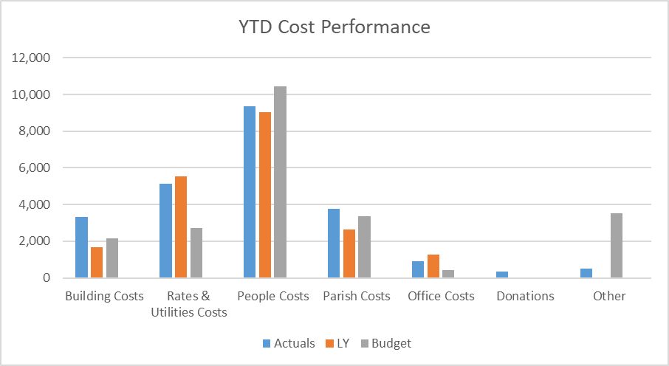
How Parish Funds are used
For 2022, we are forecasting spending of around £69,000. This includes £15,000 for a project of refitting the Parish office and its furniture and storage. During 2021 the Parish spent almost £50,000 on the replacement of lighting in the Church and Hall. We tend to see major refit projects every 3 years.

Slide 4
Parish Plans
The Parish has funds of c. £95,000. This is its pot of money for day-to-day maintenance as well as refit projects, and those projects can be expensive.
The Parish Finance Committee has a policy of maintaining a float of £50,000. This is the level we do not want to go below.
In the near future we will be re-assessing the state of the Church and its buildings, and we also want to make sure the Hall remains suitable for supporting Parish pastoral activities.
So we need to make careful use of the money you as parishioners give us.

Slide 5
Closing Points
The Finance Committee is sincerely grateful for your continuing support.
We especially recognize this given Covid conditions and higher costs of living.
While most of our income is subject to an assessment by the Diocese (where we remit a fraction to them), the Easter and Christmas special collections all go to the Parish and Priest.
If you like, you may want to give something at these times, which would be in addition to Planned Giving (standing orders and envelopes).
Finally, Chris Eveleigh, who prepares the Parish budget and financial report, has prepared an excellent video summary of the Parish finances, and this can be seen on the Parish FaceBook site.

Slide 6
Thank You

