Slide 1
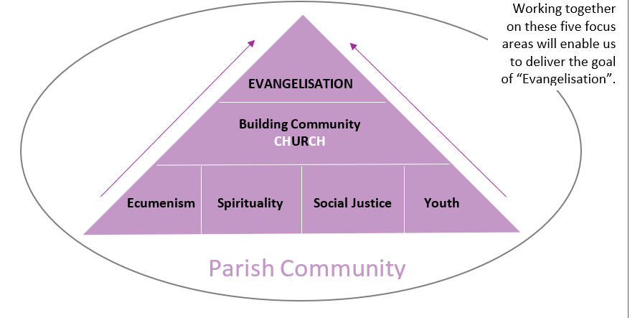
Parish Mission Statement
Evangelisation is our Parish Mission. It means proclaiming the good news of God's love throughout the world and is the role of all parishioners as we work towards being missionary disciples, i.e., listening, following and sharing our faith. Our Parish aims to evangelise by working with the local community in five areas: building community, ecumenism, spirituality, social justice and youth.

Slide 2
Social Justice / Outreach
Handicapped Children Pilgrimage (HCPT)
Monday Soup and Warm Hub
Support for Asylum Seekers
St Bart's Pantry
Fairtrade Lunch
Support For Charities e.g. Mary's Meals, CAFOD , local charities
EVANGELISATION
"Sharing The Good News“
How we do this currently at St Bart’s
Care for Others & Our Earth
Welcoming To Parish
St Vincent de Paul (SVP)
Circle Of Friends monthly social
Knights Of St Columba
Catholic Women’s League (CWL)
“Adopt a Plant”
Grow our Spirituality
Our Liturgy
Children & Youth involvement
Prepare our parishioners to feel
confident sharing their faith
via Retreats/ Adult Education
Communications/Website/Facebook
Discussions/Newman Society
Ecumenical - South St Albans * Churches Together in St Albans
RCIA

